Slide 1

Internal Knowledge Sharing - 01
Raj Desai & Aishwarya Bhangale
03/22/2022

Slide 2
Language Model Evolution

Slide 3
Evolution of Language Modelling
N-grams
(1948)
Word2Vec
(2013)
RNN
(1980)
Language Models are simply models that assign probabilities to sequences of words.
Even pretrained word embeddings are derived from language modelling i.e. Word2Vec, Glove, SVD, LSA.

Slide 4
N-grams
N-grams are continuous sequences of words or symbols or tokens in a document.
In technical terms, they can be defined as the neighboring sequences of items in a document.
By and large, majority of the NLP systems in this period were based on rules and the first few language models came in the form of N-Grams.
n | Term | Generated n-grams
1 | Unigram | [“I”, “live”, “in”, “Maryland”]
2 | Bigram | [“I live”, “live in”, “in Maryland”]
3 | Trigram | [“I live in”, “live in Maryland”]
N | n-gram | [“I live in Maryland…”]

Slide 5
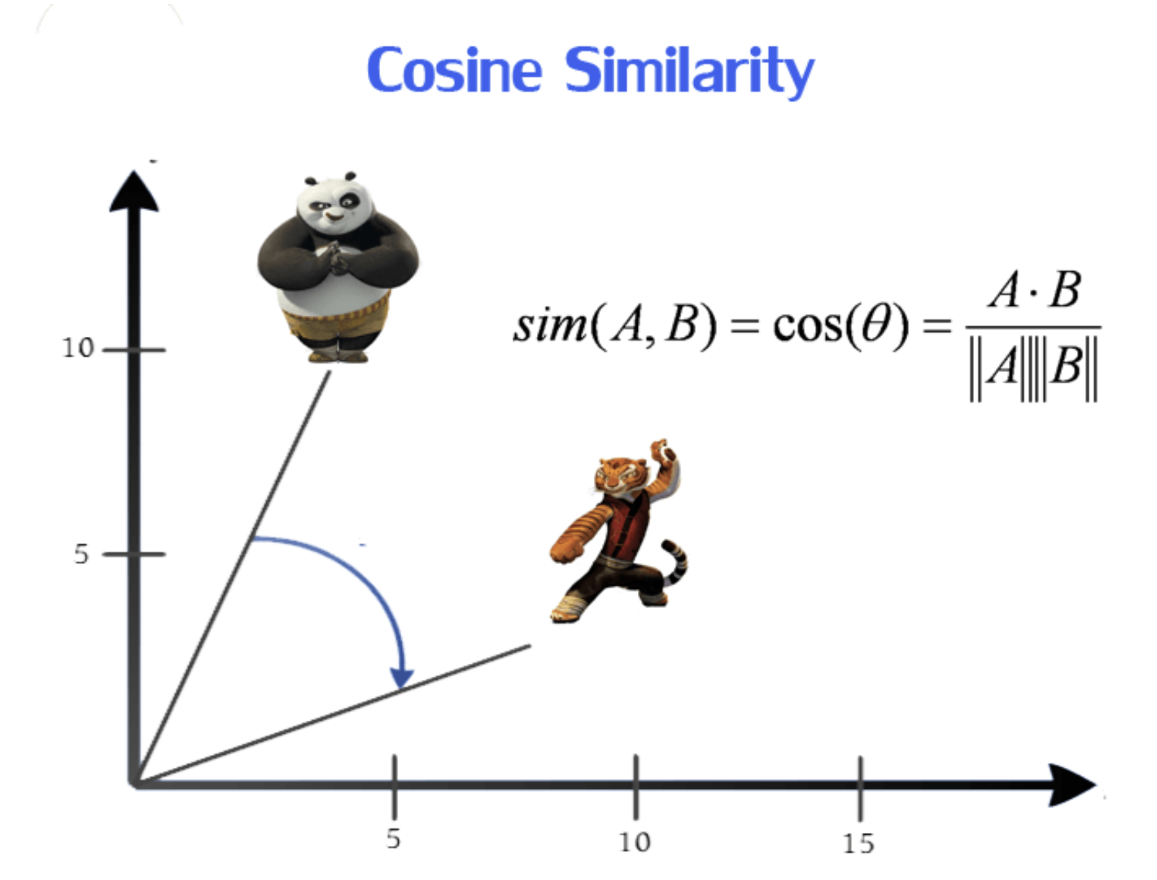
Word2Vec
Word embedding is one of the most popular representation of document vocabulary. It is capable of capturing context of a word in a document, semantic and syntactic similarity, relation with other words, etc.
Word2Vec creates vectors of the words that are distributed numerical representations of word features – these word features could comprise of words that represent the context of the individual words present in our vocabulary.

Slide 6
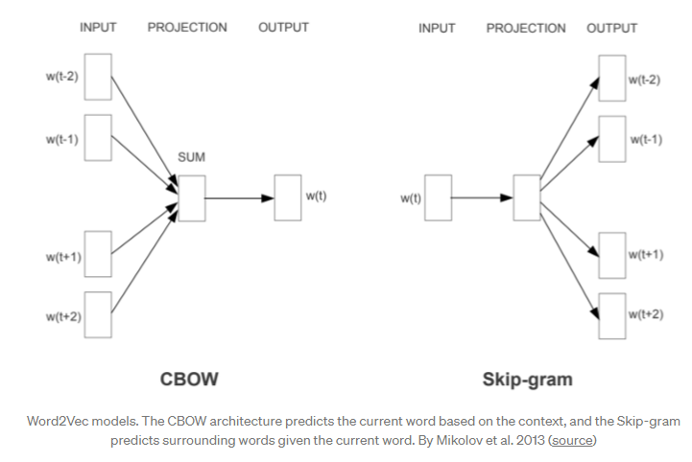
Word2Vec
There are 2 techniques of Word2Vec:
Continuous bag-of-words (CBOW)
This method takes the context of each word as the input and tries to predict the word corresponding to the context. Consider our example: Have a great day.
Skip-Gram
The Skip-gram model architecture usually tries to achieve the reverse of what the CBOW model does.
It tries to predict the source context words (surrounding words) given a target word (the center word).

Slide 7
Seq-2-Seq Models

Slide 8
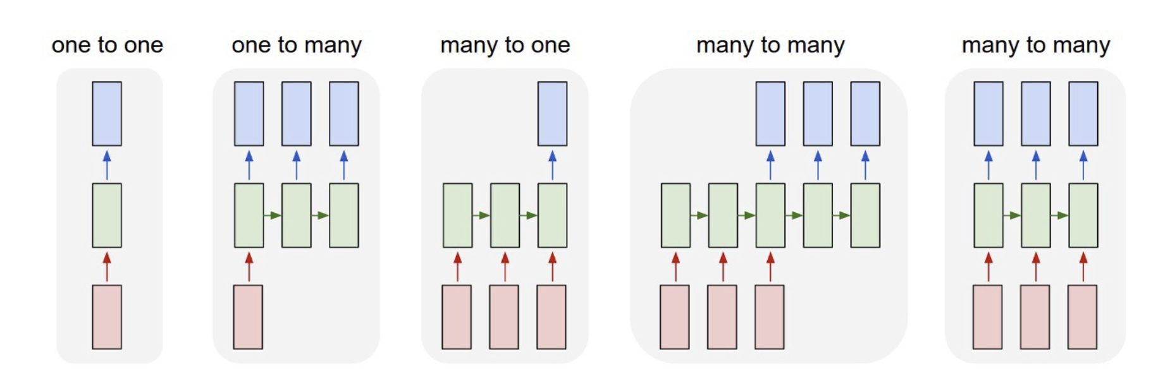
Sequence-2-Sequence Model
In Seq2Seq models, both the input and output are sequences
They encapsulate sequence of the word appearance in the input to be able to make more accurate predictions

Slide 9
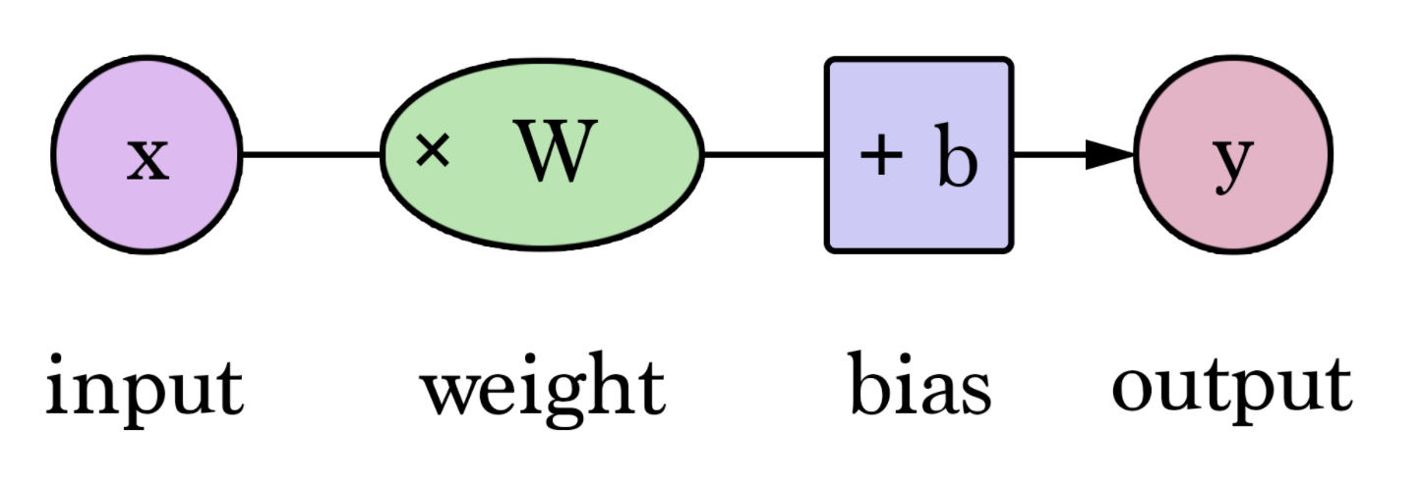
Neural Network – Basic Architecture
W and b are values we find during training the neural network
X is the input to the network
Y is the output of the network
Training a neural network involves finding the optimal value of this weight

Slide 10

Recurrent Neural Networks
First, we are going to encode the sequence of text using an RNN
Next, we are going to feed the RNN output (O5) into a feed forward neural network which will classify the truth

Slide 11
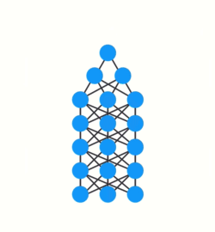
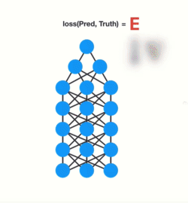
Back Propagation/Limitation of RNN
A neural network has 3 major steps:
1) Forward pass to make a prediction
2) Compares prediction to ground truth to generate an error value
3) Error value is used to do back propagation
which updates the weight for each node
When doing back propagation, each node in a layer
calculates its gradient based on the gradient in the
layer before it (as the same weight parameter is
updated across different RNN layers)
This causes gradients to exponentially
shrink as it back propagates down
Back Propagation
Vanishing Gradient Descent Problem

Slide 12

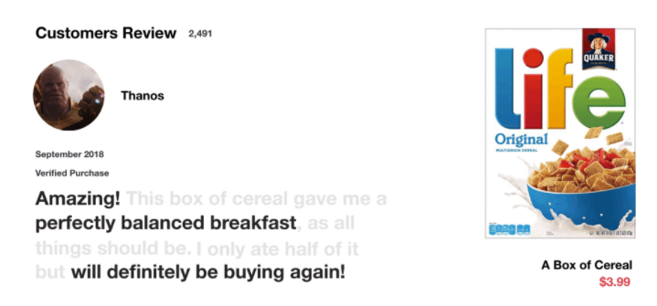
Why LSTM?

Slide 13
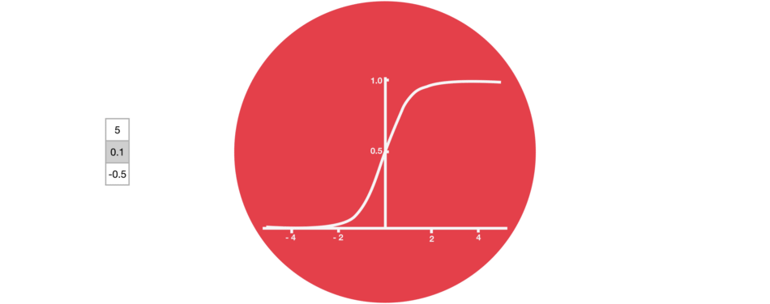
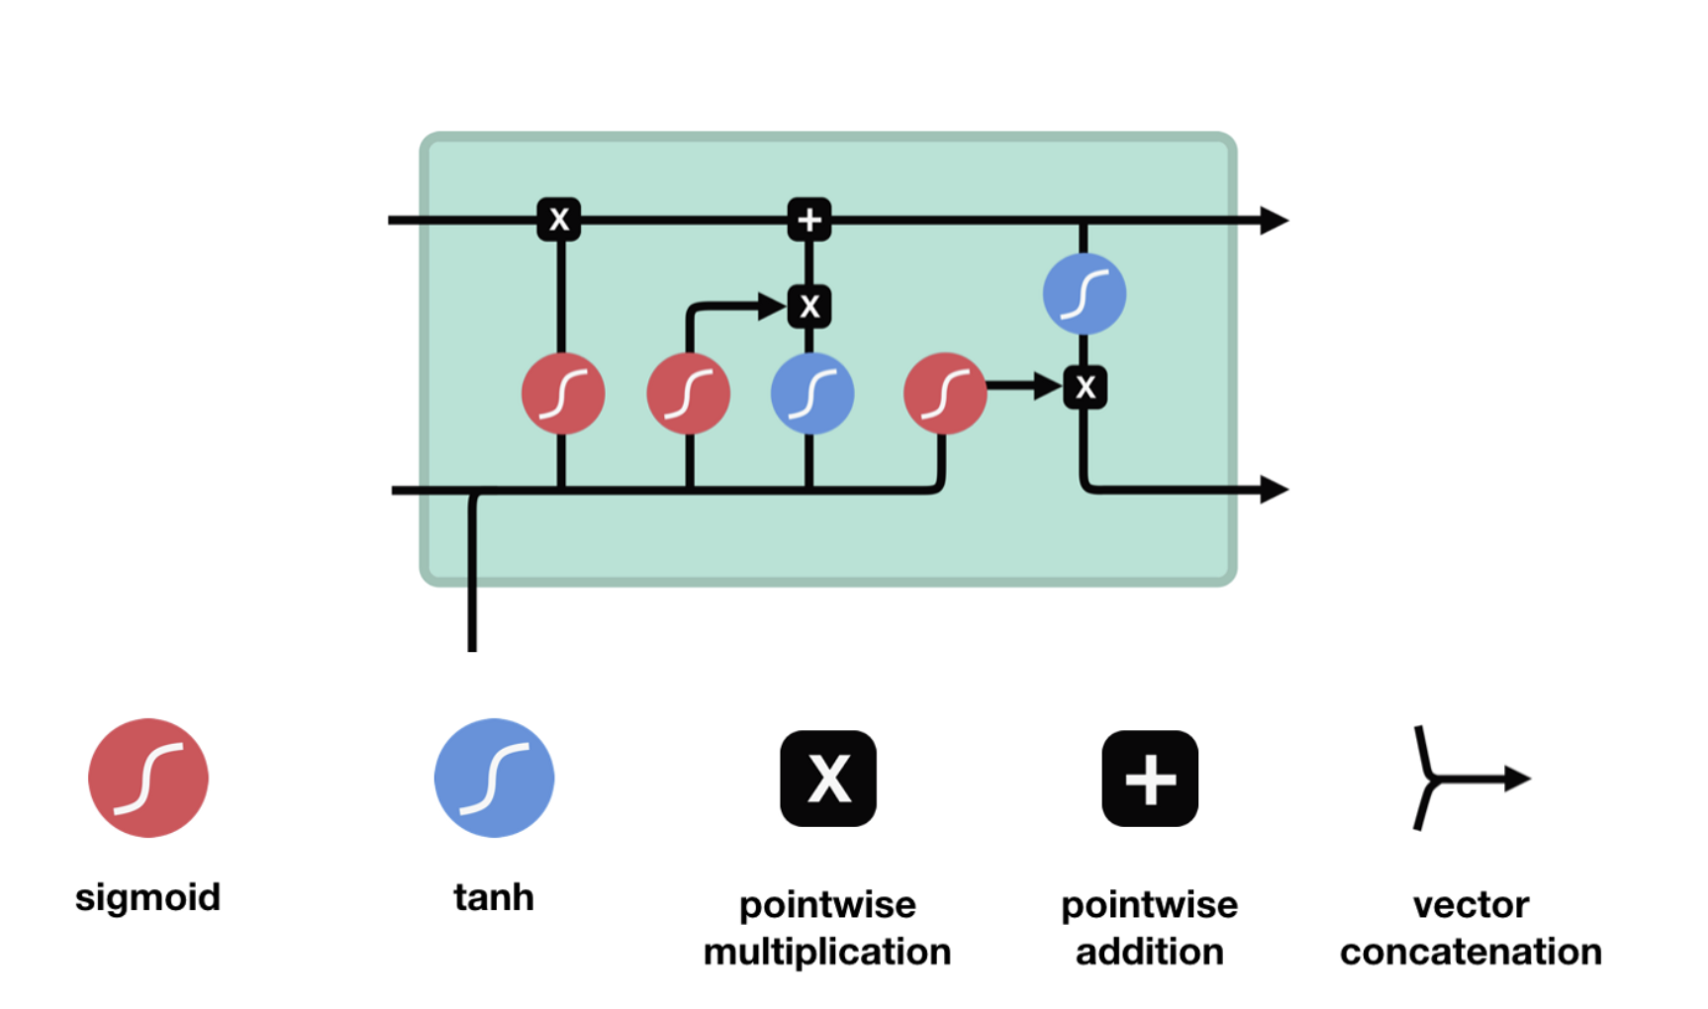
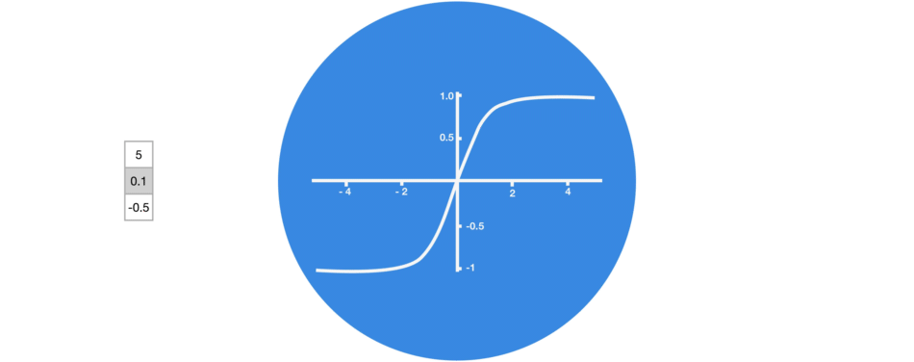
Long Short Term Memory Cell / Hidden Unit
Cell State : Long Term Memory of the model
Hidden State : Working Memory of the model
Old Cell State
New Cell State
Sigmoid function decides how much information of the existing component to retain
Old Hidden State
New Hidden State
Forget Gate How much of the old state should be forgotten?
Input Gate Which info should be saved to the cell state for the current cell?
Output Gate
Which information should move forward to the next hidden state?
Tanh distributes the gradients by scaling them between -1 to 1 thus resolving exploding/vanishing problem

Slide 14
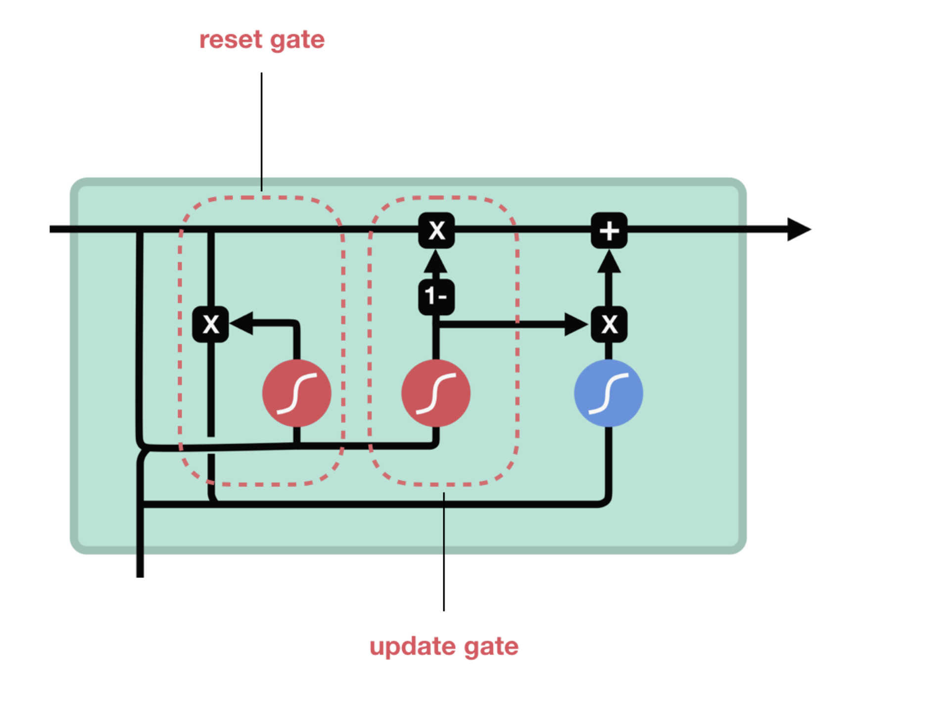
GRU
Decides how much past information to retain
Consists of two gates instead of three gates
Consists of hidden state instead of two separate states
Performs better on smaller datasets; LSTM outperforms GRU on larger datasets
Old Hidden State
New Hidden State
Input sequence
Combination of forget and input gate from LSTM
Decides what info to throw away and what new information to add

Slide 15
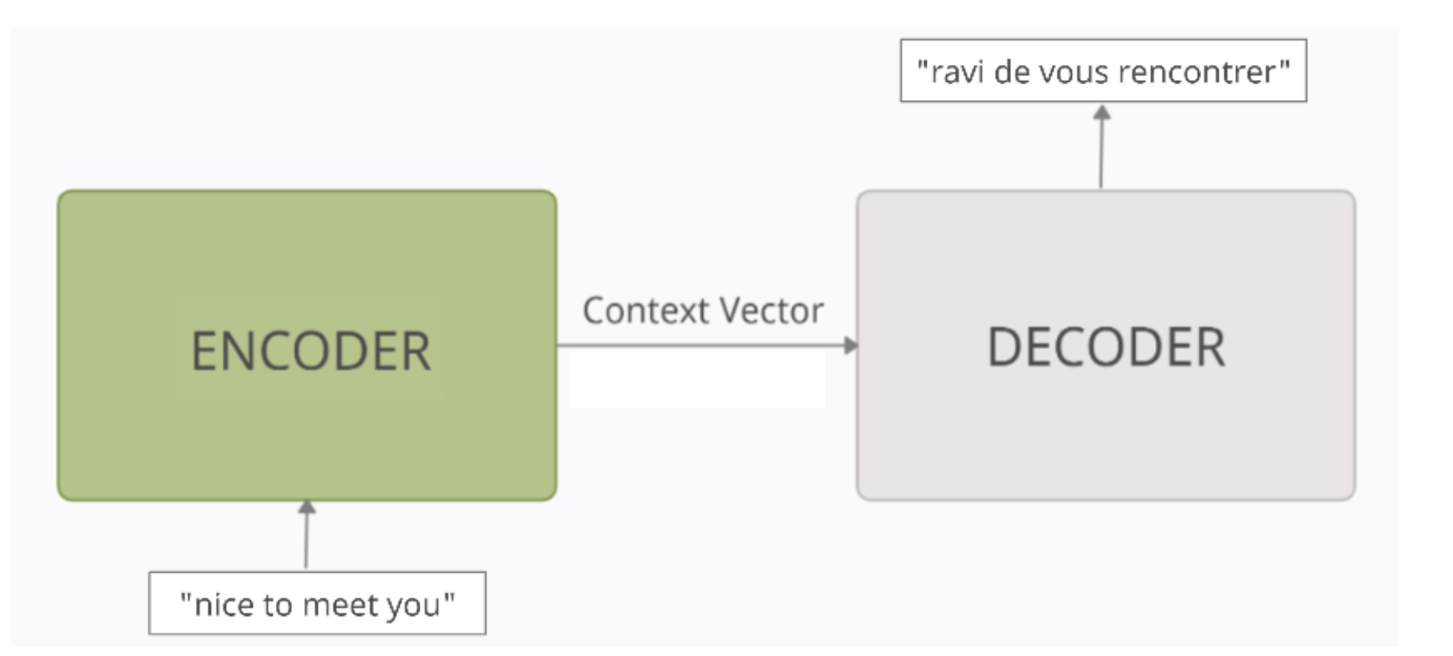
Encoders & Decoders
This architecture solves the situation when input sequence and output sequence are not the same length
Encoder process each token in input sequence and crams it into a vector of fixed length called “Context Vector” which holds the meaning of the input sequence
The decoder reads the context vector and tries to predict the target sequence token by token

Slide 16
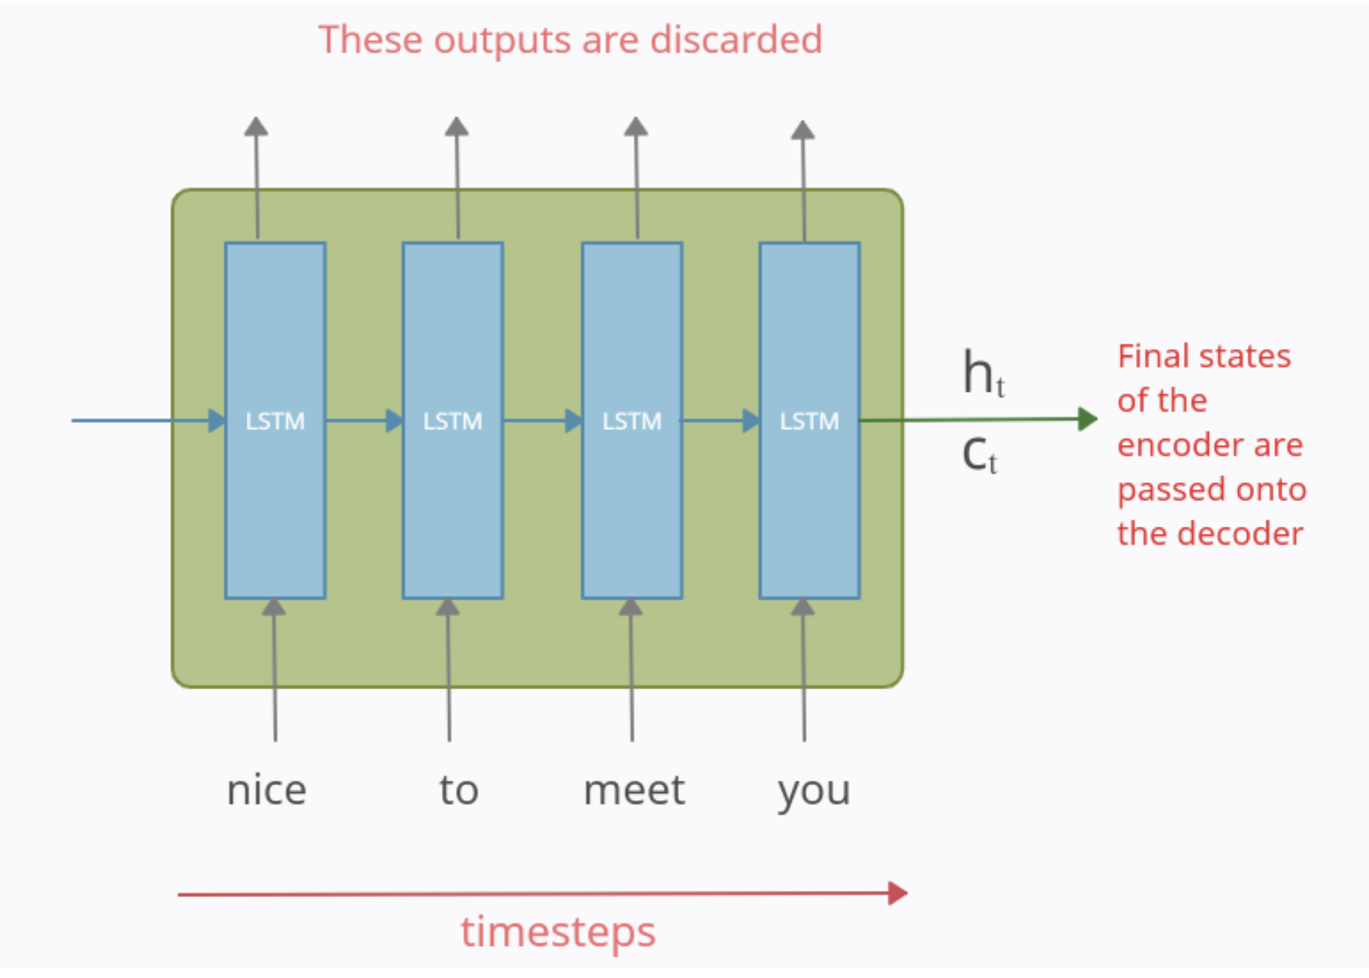
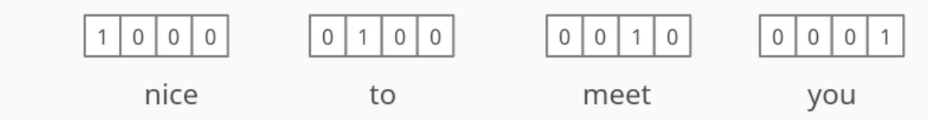
Encoders

Slide 17
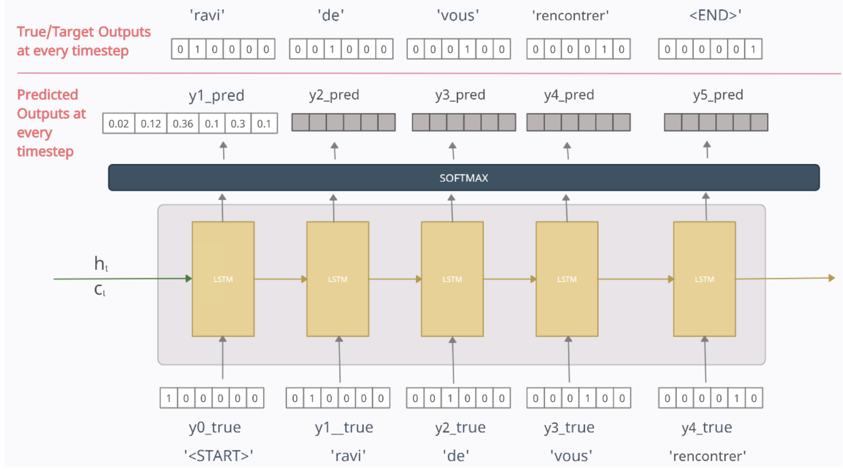
Decoders

Slide 18
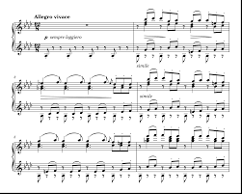


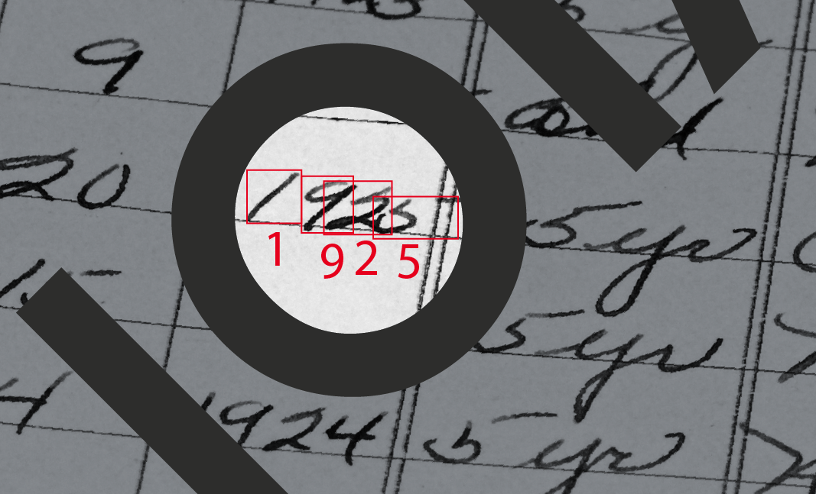
Applications of LSTM/GRU
Music composition
Time series prediction
Robot control
.
Handwriting recognition

Slide 19
Appendix

Slide 20
Drawbacks of LSTM
LSTMs became popular because they could solve the problem of vanishing gradients. But it turns out, they fail to remove it completely.
They require a lot of resources and time to get trained and become ready for real-world applications. In technical terms, they need high memory-bandwidth because of linear layers present in each cell which the system usually fails to provide for. Thus, hardware-wise, LSTMs become quite inefficient.
With the rise of data mining, developers are looking for a model that can remember past information for a longer time than LSTMs.
LSTMs are prone to overfitting

